Slide 1



Lecture Slides
Chapter 12
Lubrication and Journal Bearings
© 2015 by McGraw-Hill Education. This is proprietary material solely for authorized instructor use. Not authorized for sale or distribution in any manner. This document may not be copied, scanned, duplicated, forwarded, distributed, or posted on a website, in whole or part.

Slide 2
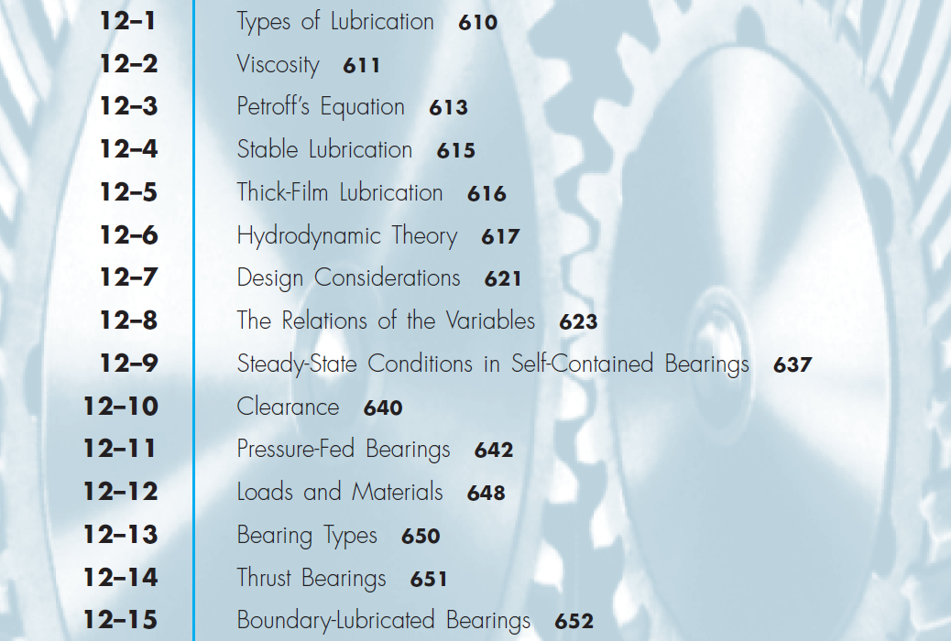
Chapter Outline

Slide 3

Lecture Slides
Chapter 12
Lubrication and Journal Bearings
The McGraw-Hill Companies © 2012

Slide 4

Chapter Outline

Slide 5
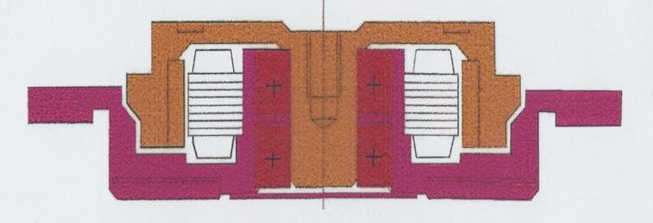
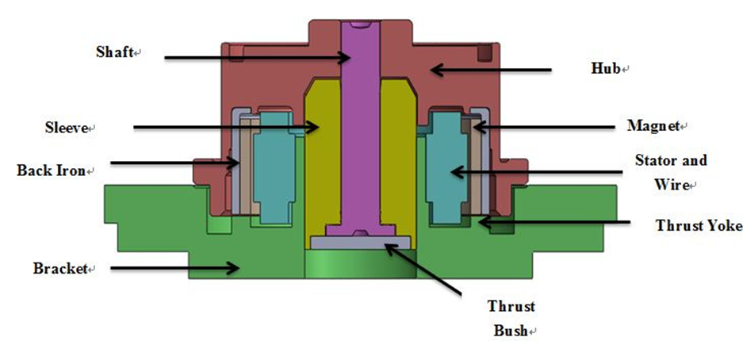

One motivation for using hydrodynamic bearing is to reduce the
diameter or even the thickness of the motor.

Slide 6

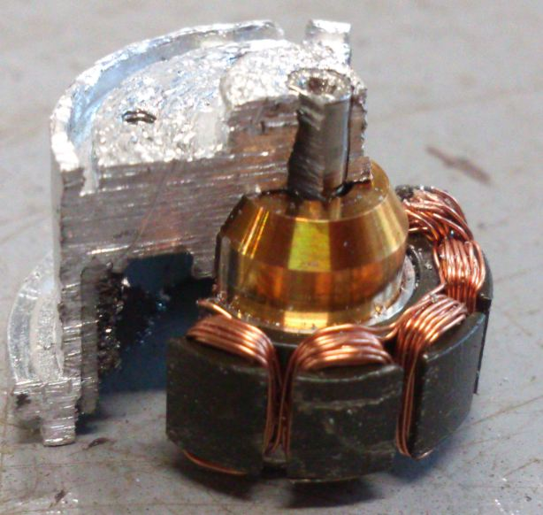

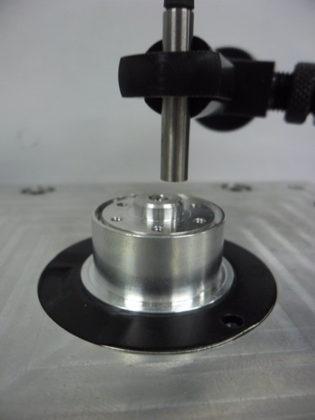
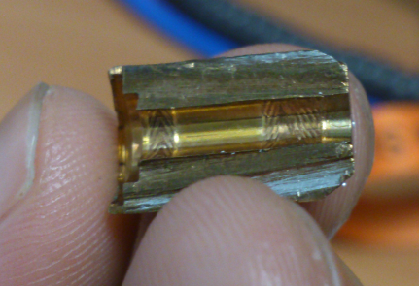
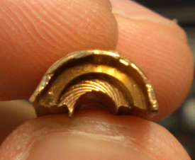
Shaft
Sleeve
硬碟機馬達系統示意圖

Slide 7
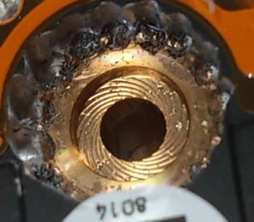
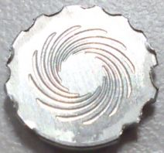
套筒(Sleeve)的螺旋溝槽
馬達底板(Thrust Bush)的螺旋溝槽

Slide 8
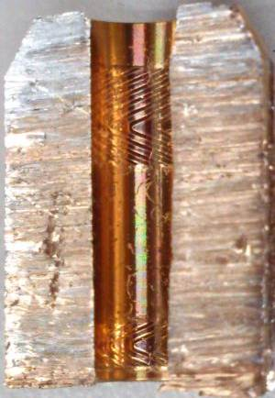
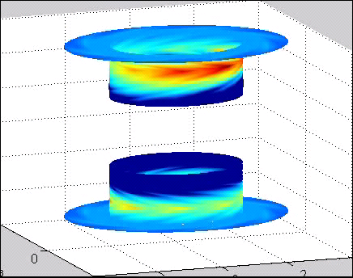
Radial Bearings
Upper radial bearing grove
pressure field
Sleeve
Upper bearing section
Lower bearing section
Bottom radial bearing grove
套筒(Sleeve)的人字形溝槽

Slide 9
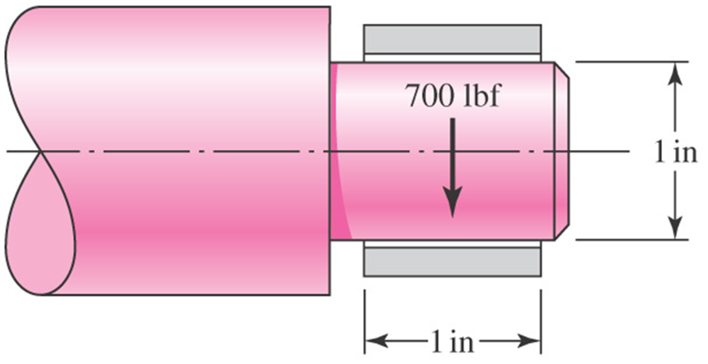

Slide 10
Objective: reduce friction, wear and heating of machine parts
Lubricant is an substance which is inserted between moving surfaces.
Sleeve bearing (plain bearing) - relative motion is sliding between shaft (journal) and sleeve (bearing)
Antifriction bearing (rolling-contact bearing, nonconforming in geometry) - relative motion is rolling.
Cam and follower (non-conforming) --sliding and rolling
Gear --sliding and rolling
Piston —sliding

Slide 11
Journal bearing: crankshaft and connecting-rod bearing (need lubricated well) of automotive engine, steam turbine.
For the service load is light and the service is relatively unimportant, a simple and easily installed bearing is required, used little or no lubrication (nylon bearing , with “built-in” lubricant power-metallurgy bearing )
在這種需求下，如用antifriction bearing 並不對，因為cost 高、加工困難或精密度高
注意：機械設計至此要用到熱流，而非只是應力、材力與材料學。

Slide 12
12-1 Types of lubrication
hydrodynamic
hydrostatic
elastohydrodynamic
boundary
solid-film

Slide 13
1. hydrodynamic lubrication –
the load-carrying surfaces of the bearing are separated by a relatively thick film of lubricant, so as to prevent metal to metal contact.
The pressure created by a sufficiently high velocity separates the surfaces against the load on the bearing.
2. hydrostatic lubrication –
Introducing lubricant, air or water, into the load- bearing area at a pressure high enough to separate the surface with relatively thick film of lubricant.
Difference of hydrostatic from hydrodynamic lubrication, motion of one surface relative to another is not required.

Slide 14
3. Elastolydrodynamic lubrication --
(1) When the contacting surfaces are non-conforming, e.g. gear teeth , or cam-follower, it is more difficult to form a full-film lubrication, since the non-conforming surfaces tend to expel rather than entrap the fluid.
(2) At low speed, boundary lubrication occurs and high wear becomes.
(3) The load creates contact patch to provide enough flat surface to allow a full hydrodynamic film to form if the relative sliding velocity is high enough.
(4) EHD is depending on the elastic deformation of the surfaces (在conforming bearing is only 1000psi), high pressure (high viscosity)
(5) Hertzian theory of contact stress and Hydrodynamic effects of fluid mechanics are used.

Slide 15
4. Boundary lubrication --
Insufficient surface area, a drop in the velocity of the moving surface ,…etc, may prevent the build-up of a film thick enough for full-film lubrication.
The film thickness is smaller than the combined height of the assertions on the opposing surfaces. Interlocking of the asperities may occur and gross seizure is presented by the coating of lubricant on the surfaces.
5.solid-film lubrication --
At extreme temperatures the ordinary mineral oils are not satisfactory, graphite or molybdenum disulfide composite bearing materials may often be used.

Slide 16
Motivations to use hydrostatic bearing (fluid, air← where to use )
使用hydrostatic bearing 之條件為何?
Assumption and formula (fluid mechanics)
如何implement, what are the formula?
如何做機械設計？

Slide 17
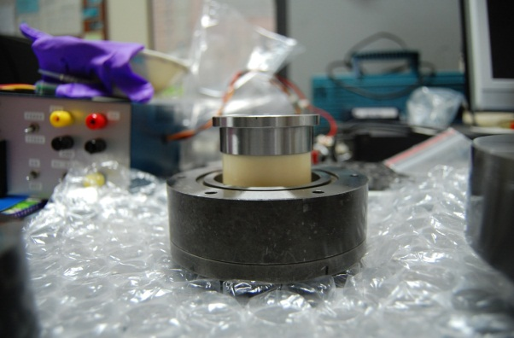
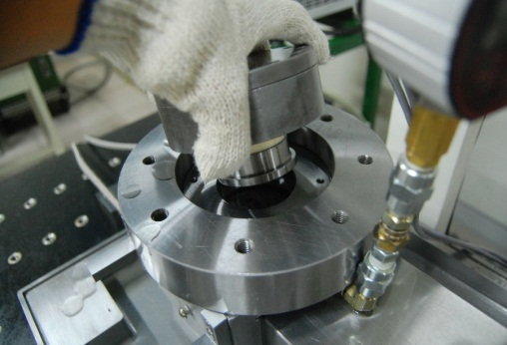
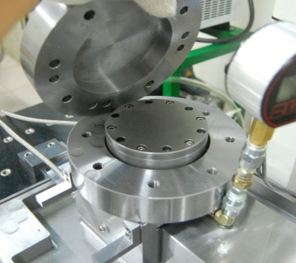
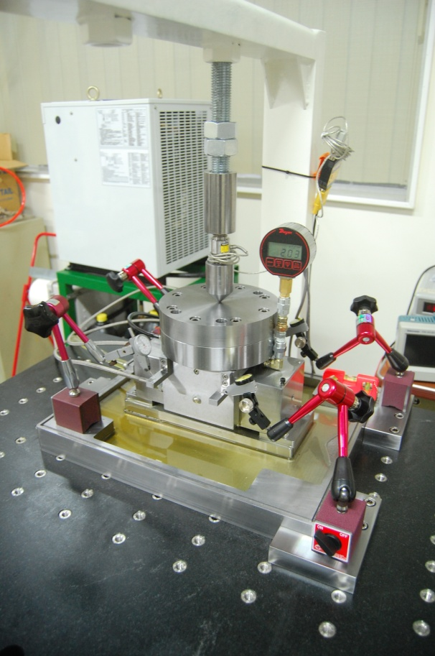
實驗目的
測量軸承搭配不同節流方式的承載力及剛性表現，以及節流系統各參數鑑定。
實驗架設
架設一受負載之液靜壓線性平台，測試其上方液靜壓油墊上方不同大小負載，量測並觀察承載力、油膜厚度改變量及油腔壓力間之關係，以得到液靜壓
負載
承載力
油腔壓力
油膜厚度
荷重元
壓力表
千分表

Slide 18
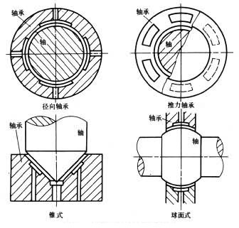

Slide 19
Types of Lubrication
Hydrodynamic
Hydrostatic
Elastohydrodynamic
Boundary
Solid film

Slide 20
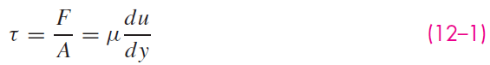
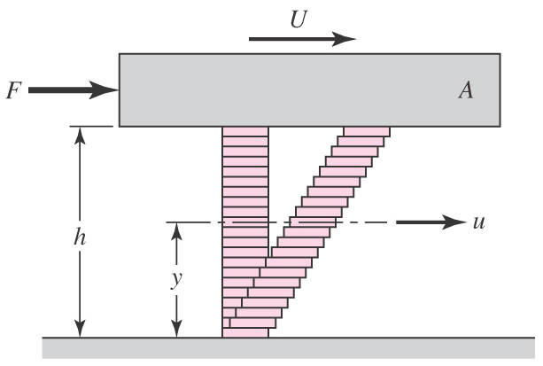
Viscosity
Shear stress in a fluid is proportional to the rate of change of velocity with respect to y
μ is absolute viscosity, also called dynamic viscosity(黏滯性
Fig. 12–1

Slide 21
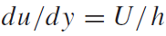
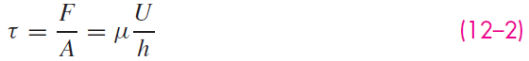
Viscosity
For most lubricating fluids, the rate of shear is constant, thus
Fluids exhibiting this characteristic are called Newtonian fluids
Fig. 12–1

Slide 22
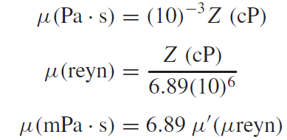
Units of Viscosity
Units of absolute viscosity
ips units: reyn = lbf·s/in²
SI units: Pa·s = N·s/m²
cgs units: Poise =dyn·s/cm²
cgs units are discouraged, but common historically in lubrication
Viscosity in cgs is often expressed in centipoise (cP), designated by Z
Conversion from cgs to SI and ips:

Slide 23
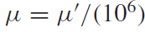
Units of Viscosity
In ips units, the microreyn (μreyn) is often convenient.
The symbol μ' is used to designate viscosity in μreyn

Slide 24
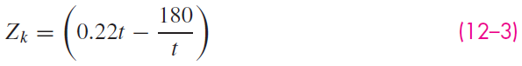
Measurement of Viscosity
Saybolt Universal Viscosimeter used to measure viscosity
Measures time in seconds for 60 mL of lubricant at specified temperature to run through a tube 17.6 mm in diameter and 12.25 mm long
Result is kinematic viscosity
Unit is stoke = cm²/s
Using Hagen-Poiseuille law kinematic viscosity based on seconds Saybolt, also called Saybolt Universal viscosity (SUV) in seconds is
where Z_{k} is in centistokes (cSt) and t is the number of seconds Saybolt

Slide 25
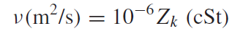
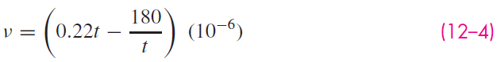
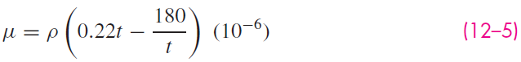
Measurement of Viscosity
In SI, kinematic viscosity n has units of m²/s
Conversion is
Eq. (12–3) in SI units,
To convert to dynamic viscosity, multiply n by density in SI units
where ρ is in kg/m³ and μ is in pascal-seconds

Slide 26
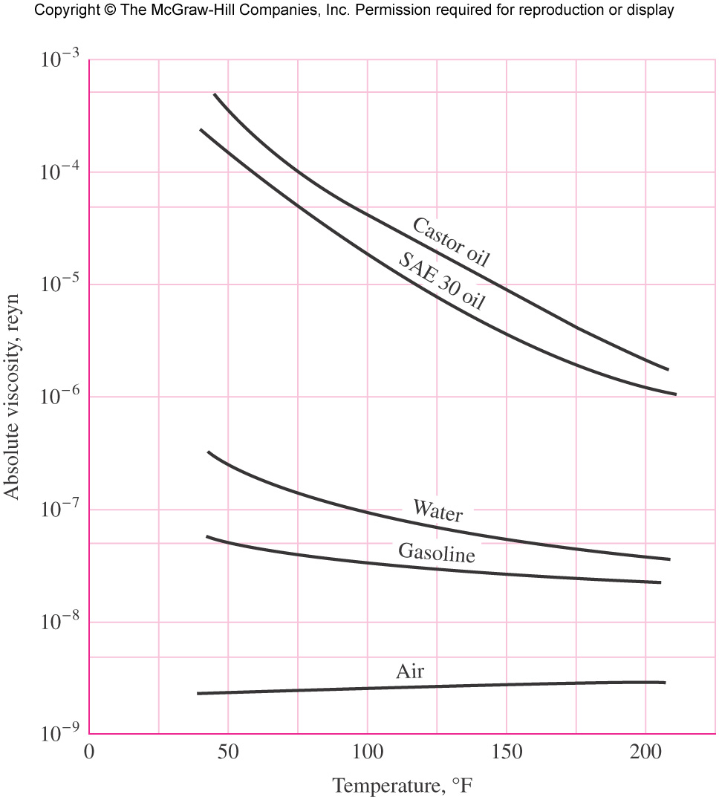
Comparison of Absolute Viscosities of Various Fluids
Fig. 12–2

Slide 27
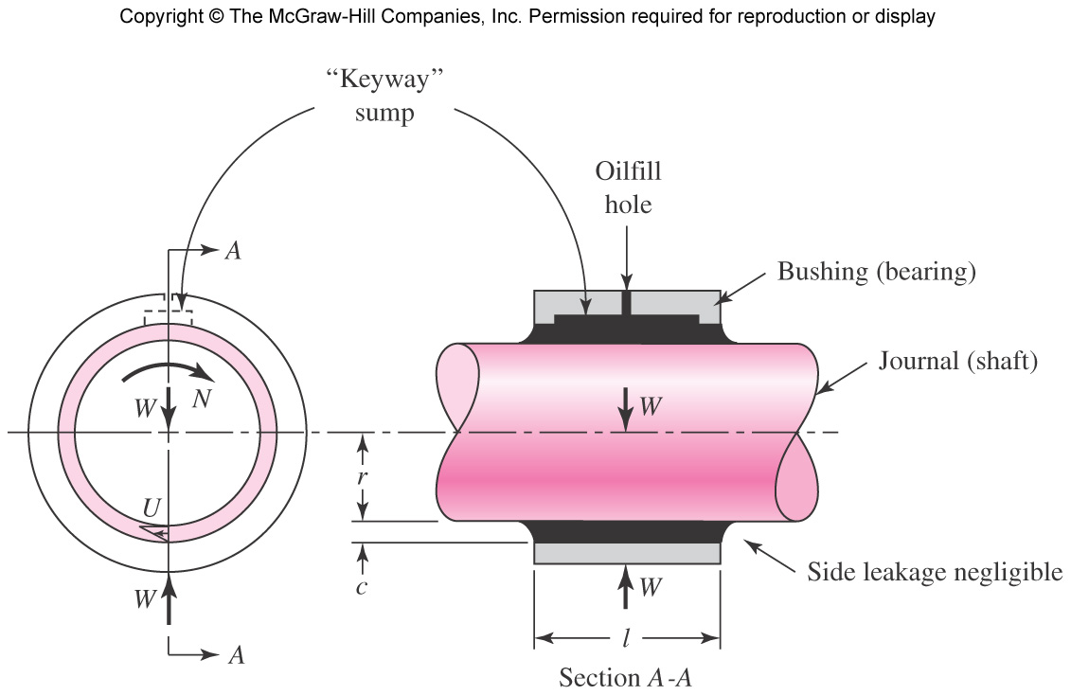
Petroff’s Lightly Loaded Journal Bearing
Fig. 12–3

Slide 28
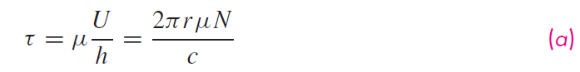
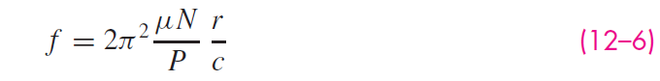
Petroff’s Equation

Slide 29
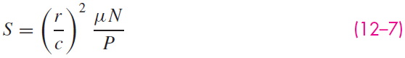
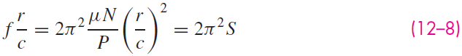
Important Dimensionless Parameters
Petroff’s equation was first published in 1883, same year as Beauchamp Tower published his paper “First Report on Friction Experiments,” Proc. Inst. Mech. Eng., Nov. 1883.
Some important dimensionless parameters used in lubrication
r/c radial clearance ratio
μN/P
Sommerfeld number or bearing characteristic number
Interesting relation

Slide 30
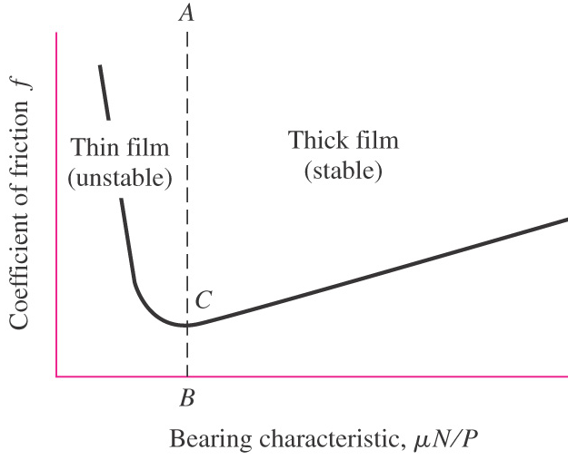
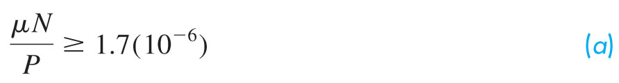
Stable Lubrication
To the right of AB, changes in conditions are self-correcting and results in stable lubrication
To the left of AB, changes in conditions tend to get worse and results in unstable lubrication
Point C represents the approximate transition between metal-to-metal contact and thick film separation of the parts
Common design constraint for point B,
Fig. 12–4

Slide 31
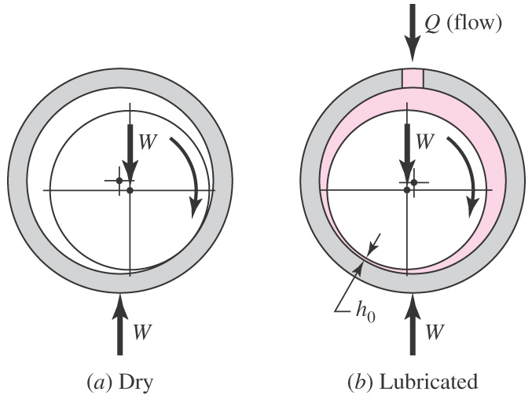
Thick Film Lubrication
Formation of a film
Fig. 12–5

Slide 32
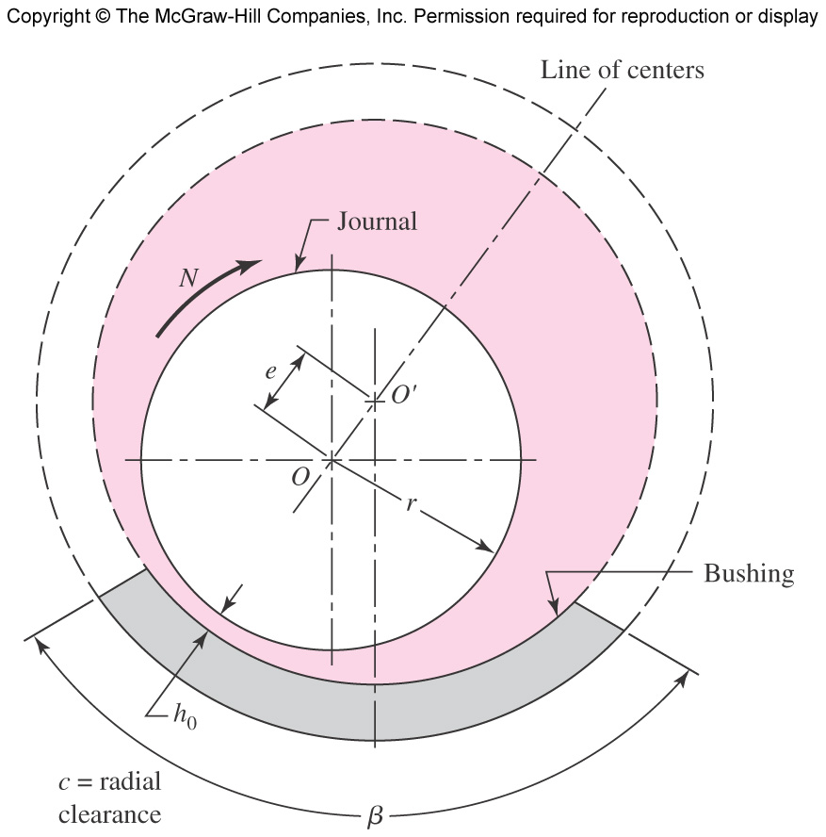
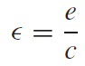
Nomenclature of a Journal Bearing
Center of journal at O
Center of bearing at O'
Eccentricity e
Minimum film thickness h₀ occurs at line of centers
Film thickness anywhere is h
Eccentricity ratio
Partial bearing has β < 360
Full bearing has β = 360
Fitted bearing has equal radii of bushing and journal
Fig. 12–6

Slide 33
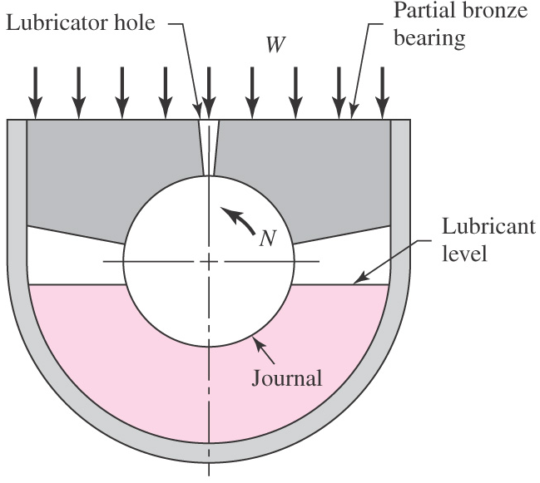
Hydrodynamic Theory
Present theory originated with experimentation of Beauchamp Tower in early 1880s
Fig. 12–7

Slide 34
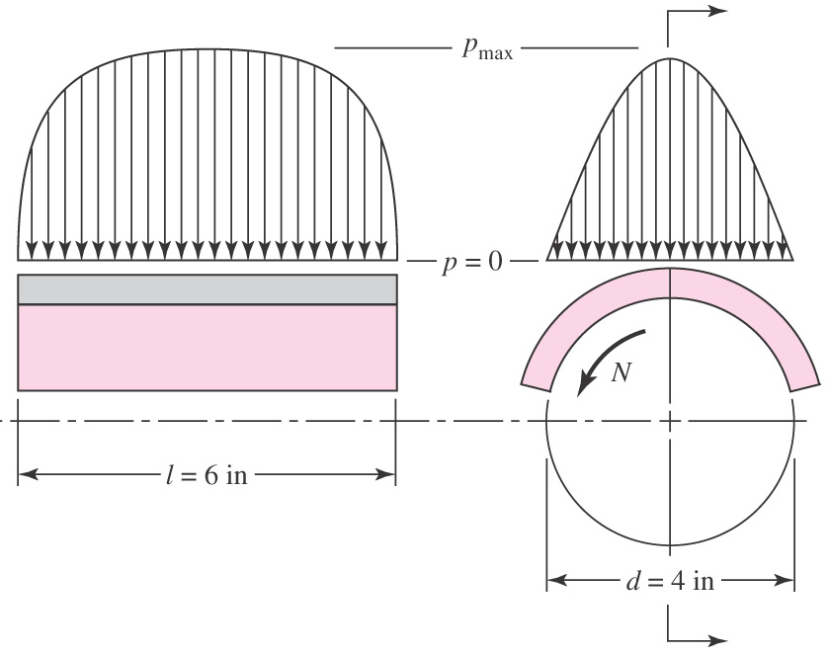
Pressure Distribution Curves of Tower
Fig. 12–8

Slide 35
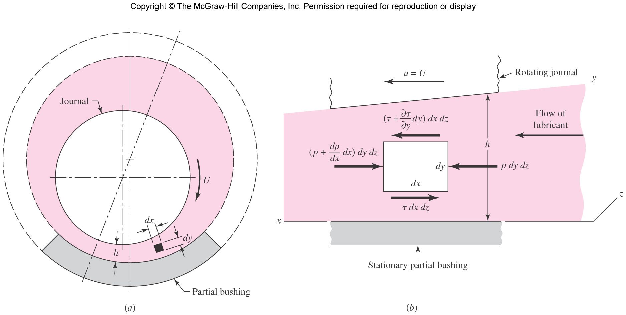
Reynolds Plane Slider Simplification
Reynolds realized fluid films were so thin in comparison with bearing radius that curvature could be neglected
Replaced curved bearing with flat bearing
Called plane slider bearing
Fig. 12–9

Slide 36
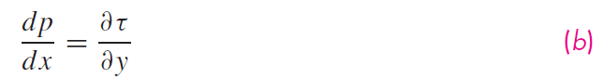
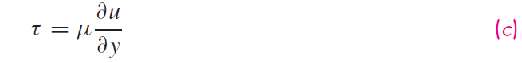
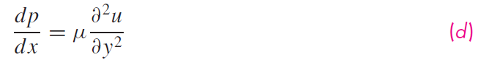
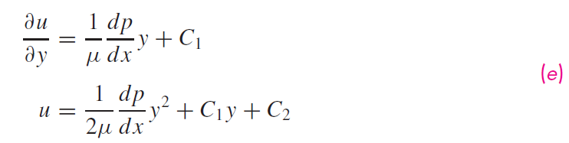
Derivation of Velocity Distribution

Slide 37
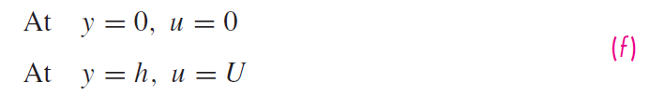
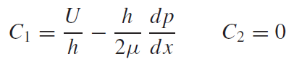
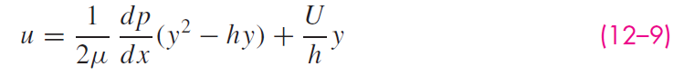
Derivation of Velocity Distribution

Slide 38
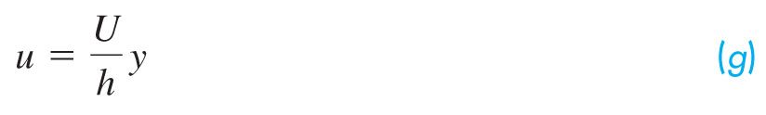
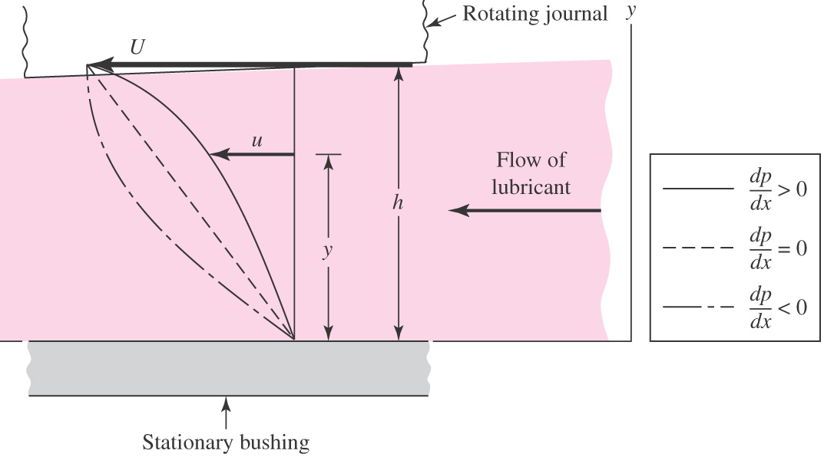
Velocity Distribution
Velocity distribution superposes parabolic distribution onto linear distribution
When pressure is maximum, dp/dx = 0 and
Fig. 12–10

Slide 39





Derivation of Reynolds Equation

Slide 40


Reynolds Equation
Classical Reynolds equation for one-dimensional flow, neglecting side leakage,
With side leakage included,
No general analytical solutions
One important approximate solution by Sommerfeld,
Osborne Reynolds, “Theory of Lubrication, Part I,”
Phil. Trans. Roy. Soc. London, 1886.

Slide 41


Slide 42


Design Considerations
Variables either given or under control of designer
Dependent variables, or performance factors

Slide 43


Significant Angular Speed
Angular speed N that is significant to hydrodynamic film bearing performance is
Fig. 12–11

Slide 44

Trumpler’s Design Criteria
Trumpler, a well-known bearing designer, recommended a set of design criteria.
Minimum film thickness to prevent accumulation of ground off surface particles
Maximum temperature to prevent vaporization of lighter lubricant components
Maximum starting load to limit wear at startup when there is metal-to-metal contact
Minimum design factor on running load

Slide 45
The Relations of the Variables
Albert Raymondi and John Boyd used an iteration technique to solve Reynolds’ equation.
Published 45 charts and 6 tables
This text includes charts from Part III of Raymondi and Boyd
Assumes infinitely long bearings, thus no side leakage
Assumes full bearing
Assumes oil film is ruptured when film pressure becomes zero

Slide 46

Viscosity Charts
Viscosity is clearly a function of temperature
Viscosity charts of common lubricants are given in Figs. 12–12 through 12–14
Raymondi and Boyd assumed constant viscosity through the loading zone
Not completely true since temperature rises as work is done on the lubricant passing through the loading zone
Use average temperature to find a viscosity

Slide 47

Viscosity-Temperature Chart in U.S. Customary Units
Fig. 12–12

Slide 48

Viscosity-Temperature Chart in Metric Units
Fig. 12–13

Slide 49

Viscosity-Temperature Chart for Multi-viscosity Lubricants
Fig. 12–14

Slide 50

Curve Fits for Viscosity-Temperature Chart
Approximate curve fit for Fig. 12–12 is given by
Table 12–1

Slide 51

Notation of Raimondi and Boyd
Polar diagram of the film pressure distribution showing notation used by Raimondi and Boyd
Fig. 12–15

Slide 52

Minimum Film Thickness and Eccentricity Ratio
Fig. 12–16

Slide 53

Position of Minimum Film Thickness
Fig. 12–17

Slide 54

Coefficient of Friction Variable
Fig. 12–18

Slide 55

Flow Variable
Fig. 12–19

Slide 56

Flow Ratio of Side Flow to Total Flow
Fig. 12–20

Slide 57

Maximum Film Pressure
Fig. 12–21

Slide 58

Terminating Position of Film
Fig. 12–22

Slide 59

Example 12–1

Slide 60

Example 12–1 (continued)

Slide 61

Example 12–2

Slide 62

Example 12–3

Slide 63

Example 12–4

Slide 64

Finding Temperature Rise from Energy Considerations
Fig. 12–23

Slide 65

Finding Temperature Rise from Energy Considerations

Slide 66



Finding Temperature Rise from Energy Considerations

Slide 67

Combined Temperature Rise Chart
Fig. 12–24

Slide 68

Interpolation Equation
Raimondi and Boyd provide interpolation equation for l/d ratios other than given in charts

Slide 69


Steady-State Conditions in Self-Contained Bearings
Previous analysis assumes lubricant carries away all enthalpy increase
Bearings in which warm lubricant stays within bearing housing are called self-contained bearings
Heat is dissipated from the housing to the surroundings

Slide 70

Heat Dissipated From Bearing Housing
Heat given up by bearing housing

Slide 71

Overall Coefficient of Heat Transfer
Overall coefficient of radiation and convection depends on material, surface coating, geometry, roughness, temperature difference between housing and surroundings, and air velocity
Some representative values

Slide 72


Difference in Housing and Ambient Temperatures
The difference between housing and ambient temperatures is given by
is the average film temperature
Table 12–2

Slide 73


Housing Temperature
Bearing heat loss to surroundings
Housing surface temperature

Slide 74



Heat Generation Rate

Slide 75



Example 12–5

Slide 76

Example 12–5

Slide 77

Example 12–5

Slide 78

Example 12–5

Slide 79

Example 12–5

Slide 80

Effect of Clearance on Example Problems
Some performance characteristics from Examples 12–1 to 12–4, plotted versus radial clearance
“h₀” stands for pressure!
Fig. 12–25

Slide 81


Clearance

Slide 82

Temperature Limits

Slide 83

Pressure-Fed Bearings
Temperature rise can be reduced with increased lubricant flow
Pressure-fed bearings increase the lubricant flow with an external pump
Common practice is to use circumferential groove at center of bearing
Effectively creates two half-bearings
Fig. 12–27

Slide 84

Flow of Lubricant From Central Groove
Fig. 12–28

Slide 85



Two-piece grooved pressure-fed connecting-rod bearing

Slide 86






Derivation of Velocity Equation with Pressure-Fed Groove

Slide 87




Derivation of Velocity Equation with Pressure-Fed Groove

Slide 88




Distribution of Velocity
Fig. 12–29

Slide 89

Side Flow Notation
Fig. 12–30

Slide 90



Derivation of Side Flow with Force-fed Groove

Slide 91

Characteristic Pressure
The characteristic pressure in each of the two bearings that constitute the pressure-fed bearing assembly is

Slide 92

Typical Plumbing with Pressure-fed Groove
Fig. 12–31

Slide 93




Derivation of Temperature Rise with Pressure-Fed Groove

Slide 94


Derivation of Temperature Rise with Pressure-Fed Groove

Slide 95



Example 12–6

Slide 96

Example 12–6

Slide 97

Example 12–6

Slide 98


Example 12–6

Slide 99

Example 12–6

Slide 100

Typical Range of Unit Loads for Sleeve Bearings
Table 12–5

Slide 101

Some Characteristics of Bearing Alloys
Table 12–6

Slide 102


Bearing Types
Fig. 12–32
Fig. 12–33

Slide 103

Typical Groove Patterns
Fig. 12–34

Slide 104

Thrust Bearings
Fig. 12–35

Slide 105

Pressure Distribution in a Thrust Bearing
Fig. 12–36

Slide 106

Flanged Sleeve Bearing
Flanged sleeve bearing can take both radial and thrust loads
Not hydrodynamically lubricated since clearance space is not wedge-shaped
Fig. 12–37

Slide 107
Boundary-Lubricated Bearings
Relative motion between two surfaces with only a partial lubricant film (not hydrodynamic) is called boundary lubrication or thin-film lubrication.
Even hydrodynamic lubrication will have times when it is in thin-film mode, such as at startup.
Some bearings are boundary lubricated (or dry) at all times.
Such bearings are much more limited by load, temperature, and speed.

Slide 108


Limits on Some Materials for Boundary-Lubricated Bearings
Table 12–7

Slide 109



Linear Sliding Wear
Fig. 12–38

Slide 110

Wear Factors in U.S. Customary Units
Table 12–8

Slide 111

Coefficients of Friction
Table 12–9

Slide 112
Wear Equation with Practical Modifying Factors
It is useful to include two modifying factors in the linear wear equation
f₁ to account for motion type, load, and speed (Table 12–10)
f₂ to account for temperature and cleanliness conditions (Table 12–11)

Slide 113

Motion-Related Factor f₁
Table 12–10

Slide 114

Environmental Factor f₂
Table 12–11

Slide 115









Pressure Distribution on Boundary-Lubricated Bearing
Nominal pressure is
Pressure distribution is given by
Vertical component of p dA is
Integrating gives F,
Fig. 12–39

Slide 116



Pressure and Velocity
Using nominal pressure,
Velocity in ft/min,
Gives PV in psi·ft/min
Note that PV is independent of D

Slide 117
Bushing Wear
Combining Eqs. (12–29), (12–31), and (12–27), an expression for bushing wear is

Slide 118
Length/Diameter Ratio
Recommended design constraints on length/diameter ratio

Slide 119

Example 12–7

Slide 120

Example 12–7
Fig. 12–40

Slide 121

Example 12–7
Table 12–12

Slide 122

Example 12–7

Slide 123




Temperature Rise for Boundary-Lubrication

Slide 124


Example 12–8

Slide 125

Example 12–8

Slide 126

Example 12–8
Table 12–13

Slide 127

Example 12–8

Slide 128

Example 12–8

Slide 129

Example 12–8

